Slide 1
AI LAB:
12-MONTH ROADMAP
A Blueprint for Scalable, Cost-Effective Enterprise AI

Slide 2

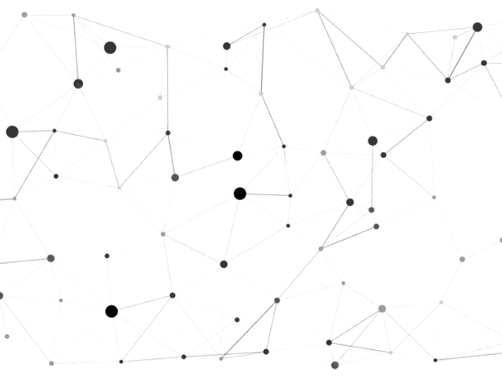
Vision — Cost-Effective AI Infrastructure
■
Democratized Research: Empower employees to research and prototype with zero per-token cost barriers.
■
Risk-Free Infrastructure: Utilize existing idle enterprise CPU infrastructure before requesting any CapEx for specialized hardware.
■
Cost-Optimized Setup: Phase in advanced computing strictly based on proven demand and measured ROI.
■
Strategic Evolution: Begin fully local on CPUs, burst to cloud only when necessary, and eventually procure targeted GPUs.

Slide 3






Architecture — Local CPU + Cloud Bursting
The Architecture
The Engine
The Evolution
Repurpose existing office servers, virtual machines, or idle developer desktops to establish the initial computing foundation.
Deploy highly optimized, quantized open-weight Small Language Models (SLMs) that run efficiently on standard CPU RAM using Ollama.
Begin with a 100% CPU-based local deployment. Introduce dynamic cloud bursting later, followed by a targeted local GPU procurement.

Slide 4

MVP 1 | Months 1–3 — Foundation (Zero GPU)
Infrastructure & Cost
Software & Access
■
Infrastructure: Provision 1–2 existing virtual machines (VMs) or bare-metal CPU servers with high RAM (32GB+).
■
Software Stack: Install Ollama with Open WebUI. Serve quantized (4-bit) models like Llama 3 8B or Mistral 7B.
■
Cost Goal: Maintain a strict $0 Capital Expenditure (CapEx).
■
Access: Onboard 15–20 internal champions for initial usage.
■
Objective: Prove internal demand and establish a secure, private sandbox without requesting a new hardware budget.
■
Focus: Text summarization, brainstorming, and internal drafting where CPU-speed inference is sufficient.

Slide 5

MVP 1 — Technical Architecture
The Local Engine
Hardware: Utilizing repurposed existing VM servers to form the core compute layer, ensuring zero initial procurement delay.
Serving: Implementing highly optimized CPU inference frameworks (llama.cpp) for maximum local throughput.
UI: A centralized, user-friendly web portal ensures no technical expertise is required for employees to begin researching.

Slide 6

MVP 2 | Months 4–6 — Dynamic Routing
Intelligent Scaling
The Logic & Milestone
■
Challenge: As adoption grows, certain heavy tasks (e.g., massive code generation) will exceed CPU inference limits.
■
The Logic: Standard queries stay on free, local CPUs. Advanced reasoning requests "burst" to an external cloud API.
■
Solution: Introduce a smart gateway (e.g., LiteLLM) to intelligently manage costs and route traffic.
■
Milestone: Demonstrate to leadership that 80% of queries are handled for free locally.
■
Value: Prove significant cost savings in API fees while only 20% require paid cloud routing.
■
Budget: Utilize a strict, pre-approved monthly budget for necessary cloud overflow.

Slide 7
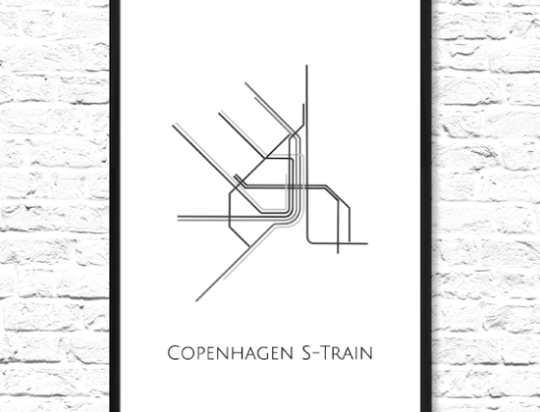
MVP 2 — Intelligent Request Flow
■
User Prompt: Employee submits a query via the unified interface.
■
The Gateway: LiteLLM proxy analyzes the request's complexity.
■
Local Priority (80%): Standard tasks are routed to local CPU models (Llama 3 8B), incurring zero marginal cost.
■
Cloud Bursting (20%): Highly complex reasoning tasks securely bypass local servers to query a managed cloud API within strict budget limits.

Slide 8






MVP 3 | Months 7–9 — AIaaS & First GPUs
Hardware Procurement
Developer Platform
Multi-Tenancy
Introduce AI-as-a-Service (AIaaS). Provide API endpoints (vLLM) so internal engineers can build models directly into company applications.
Implement strict rate limits and quotas to ensure fair, optimized sharing of the new GPU resources across various departments.
Armed with 6 months of ROI data, purchase a mid-range, multi-GPU workstation to pull the remaining 20% of workloads entirely in-house.

Slide 9

MVP 3 — Developer Platform
Empowering Builders
Platform Shift: Transitioning from a simple chat UI to a robust API platform tailored for internal engineers.
Integration: Developers can programmatically access local models to automate workflows and integrate AI into existing internal software.
Cost-Free Testing: Local innovation cycles allow teams to run thousands of API calls during development without public cloud charges.

Slide 10

MVP 4 | Months 10–12 — Specialized Workloads
Advanced Customization
Enterprise Scale
■
Fine-Tuning: Use the newly acquired local GPUs for parameter-efficient fine-tuning (LoRA).
■
Knowledge Integration: Connect the models to internal databases and wikis via Private RAG workflows.
■
Proprietary Data: Train open models specifically on the company’s proprietary codebases, specific tone, and historical data.
■
Secure Access: Allow employees to query company knowledge securely without data leaving the firewall.

Slide 11




12-Month Timeline — Month 1 → Month 12
MVP 2 (M 4-6)
MVP 4 (M 10-12)
Dynamic Routing. LiteLLM proxy manages CPU vs. Cloud Bursting.
Scale & Customization. Fine-tuning and Private RAG on company data.
MVP 1 (M 1-3)
MVP 3 (M 7-9)
Foundation. Zero GPU / CPU-Only setup. Ollama and WebUI deployed.
AIaaS & First GPUs. Dedicated hardware procured based on proven ROI.

Slide 12
END STATE
A scalable, shared, cost-optimized AI Lab operating entirely on-premise, generating internal tools and IP with zero ongoing token costs.

Slide 13




Image Sources
https://as2.ftcdn.net/v2/jpg/21/20/06/57/1000_F_2120065732_aP705dZWg7GFq01vHOwtZwF3oCSpOuC8.jpg
Source: www.ukposters.co.uk
https://www.dlrgroup.com/media/10_16206_00_N6_weblg-2140x1427.jpg
Source: www.dlrgroup.com
https://i.etsystatic.com/10156036/r/il/a58a80/1012045664/il_570xN.1012045664_3779.jpg
Source: www.etsy.com
https://images.stockcake.com/public/4/7/a/47a212ee-e10e-41bd-adcd-f82eef620348_large/minimal-developer-workspace-stockcake.jpg
Source: stockcake.com

